Slide 1

G2M INSIGHT FOR CAB INVESTMENT FIRM
10-19-2022

Slide 2
Background
• XYZ is a private equity firm in US. Due to remarkable growth in the Cab Industry in last few years and multiple key players in the market, it is planning for an investment in Cab industry.
• Objective : Provide actionable insights to help XYZ firm in identifying the right company for making investment.
The analysis has been divided into four parts:
• Data Understanding
• Forecasting profit and number of rides for each cab type
• Finding the most profitable Cab company
• Recommendations for investment

Slide 3
Problem Statement
Analyze the data and predict which cab company is better for profits.
There is no significant difference of profit regarding age
Population influence the profit for cab riders
Cities effect on number of users
Number of users have positive difference in price of cab
Higher the population, higher the cab riders
Customers over 50 rides cab less

Slide 4
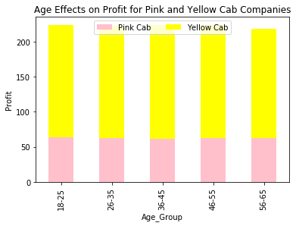
Age Effects on Profit
There is no significant difference in Profit with age. But Yellow cab made higher profits in all age group compared to pink cab.

Slide 5
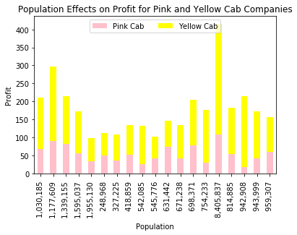
Population Effects on Profit
Yellow cab gains a higher profit
for all population

Slide 6
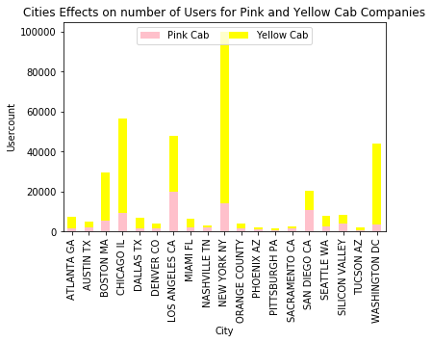
Cities Effect on number of Users
Cities have significance influence on cab users and usage of yellow cab is higher in all cities

Slide 7
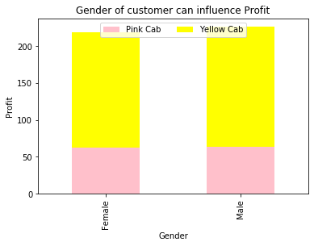
Gender Based Profit
Gender of customer doesn’t influence profit, but Yellow cab made higher profit in both genders

Slide 8
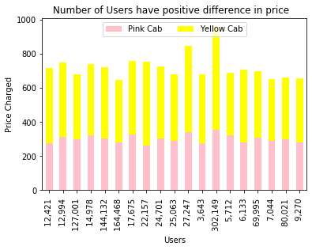
Effect of price based on number of users
There is no significant effect on price based on number of users. Usage of Yellow cab is higher

Slide 9
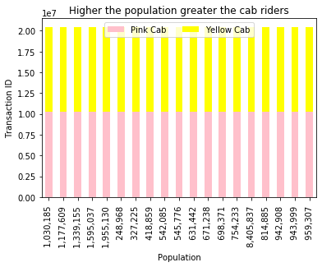
Population Effect on Cab Riders
Population has no significant influence on cab riders. But Pink and Yellow cab has been used equally

Slide 10
Customers over 50 rides cab less
Age has no significant effect on Cab riders. But usage of Yellow cab was higher in all age group compared to pink cab.

Slide 11
Recommendations
I have evaluated both the cab companies on following points and found Yellow cab is better than the Pink cab:
Age wise Profit : Yellow cab has higher customers in all age group. Profit is equal for all age groups
Population wise Profit: Yellow cab has higher profit for all population
Customer Reach : Yellow cab has higher customer reach in all cities
Gender wise Profit: Yellow cab makes higher profit in both genders.
User wise Price: Price doesn’t change based on Users. Yellow cab is used more often than Pink Cab
Based on above observation , I recommend Yellow cab for investment.

Slide 12
Thank You

